Slide 1


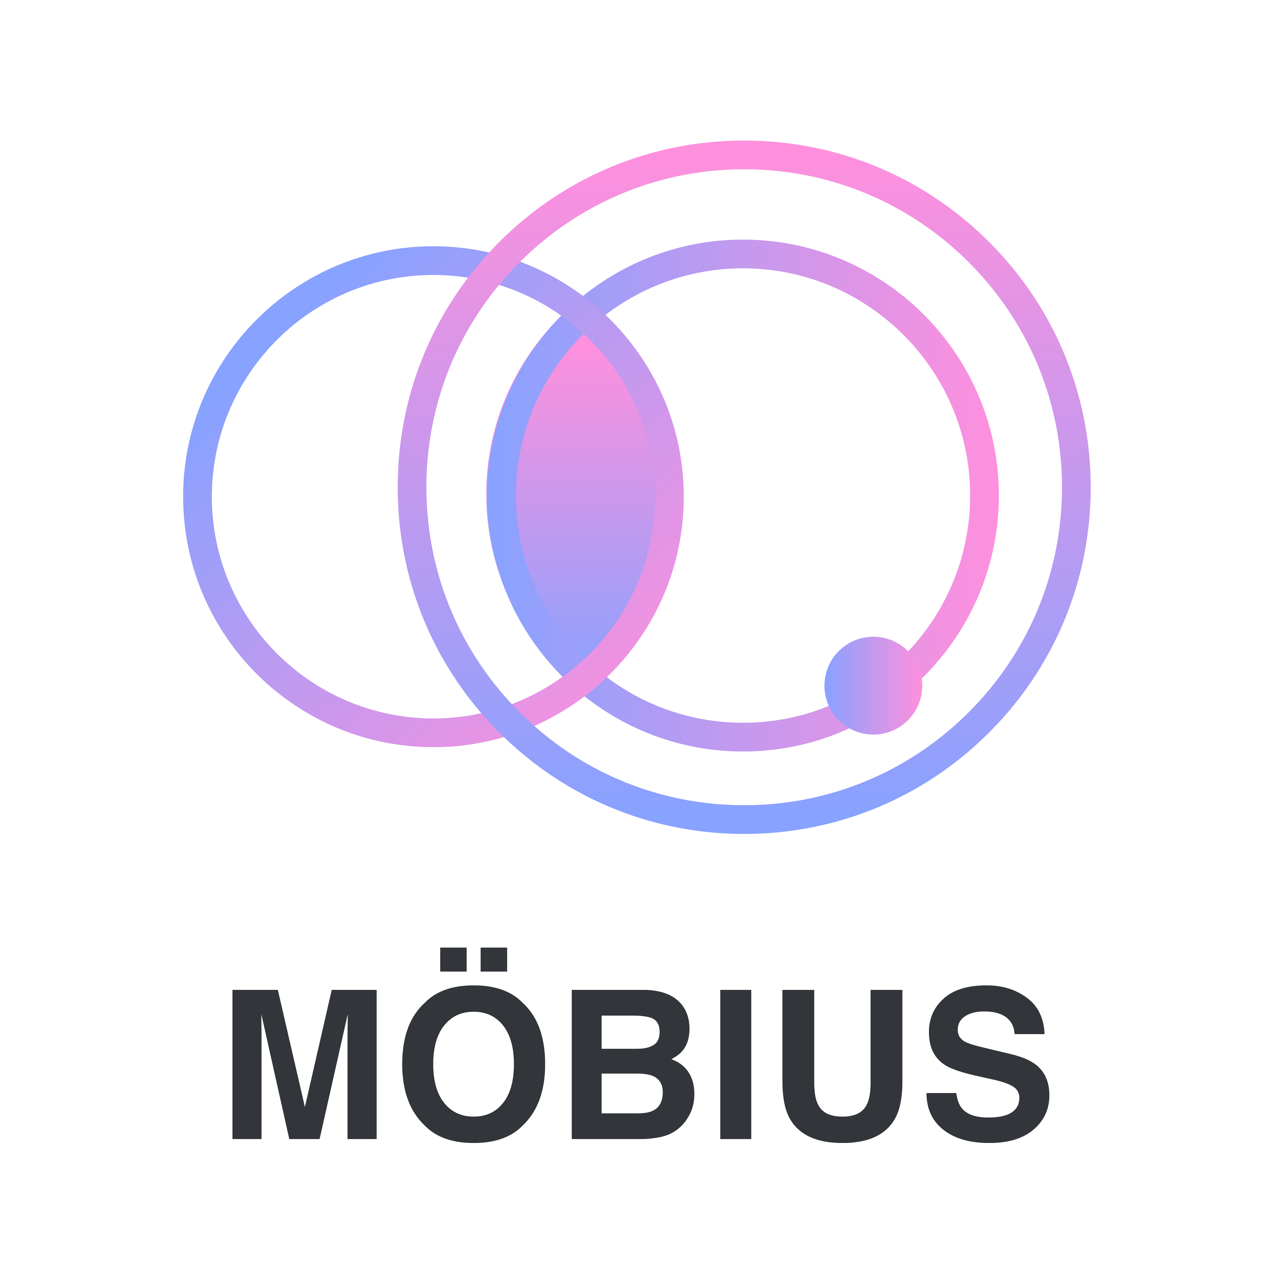
FINANCE
Trade Without Limits
2021

Slide 2

CONTENTS
01
02
03
04
05
What does Mobius
think about synthetic
assets?
The existing problems
and future potentials
of synthetic assets
Mobius Finance
Product features
Innovating on the Global Debt model
The future of synthetic
assets

Slide 3
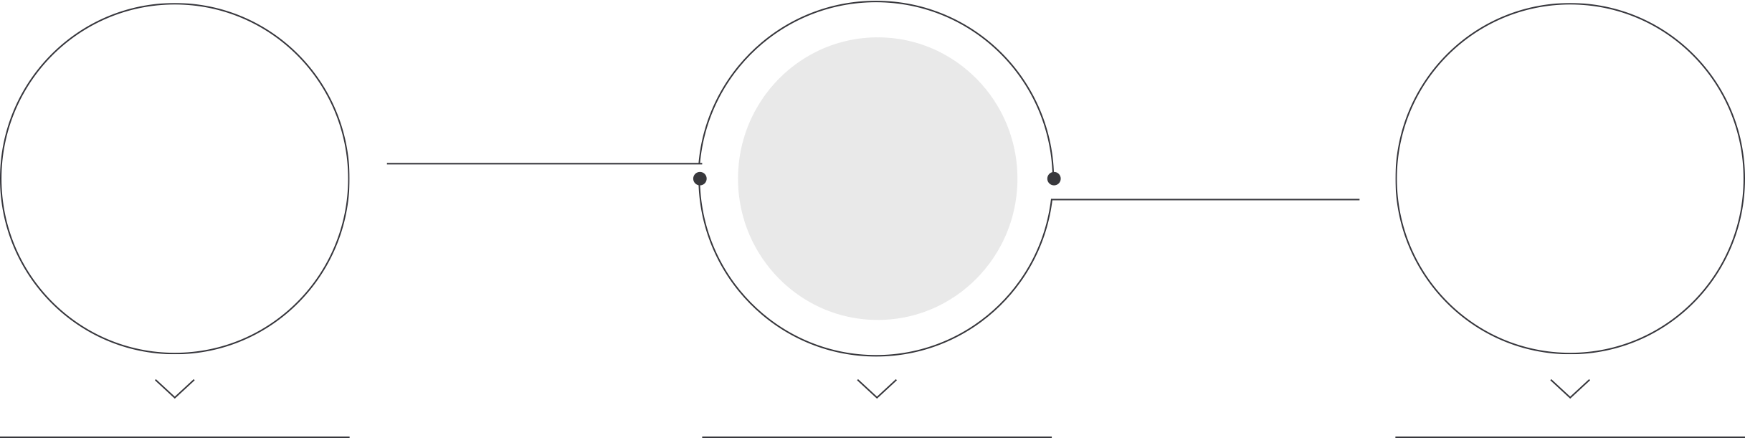



01
What does Mobius think about synthetic assets?
infrastructure
Cross-chain scheme
No slippage,
unlimited liquidity exchange
Synthetic asset projects should be one of the key infrastructure of the entire DeFi ecosystem, since synthetic assets are the most feasible approach which allow traditional financial assets to access the blockchain world.
In the form of prediction machine quotation, synthetic assets can enable users to break through the limitation of block chain and capture the value of various assets.
In fact, it is also a kind of "cross-chain".
The global debt + quotation-driven trading model enables synthetic assets to have unlimited liquidity and a trading experience without slippage.

Slide 4
02
The existing problems and future potentials of synthetic assets
——1.Reasons why synthetic assets cannot be further advanced by existing models
A
B
C
D
The inherent logic of synthetic assets is complex, and the cost of smart contract execution is too high.
Limited Assets Scope
Poor product design and high debt risk
Complex trading model

Slide 5
02
The existing problems and future potentials of synthetic assets
——2.The potential of synthetic assets
A
B
C
Expand the asset scope of the DeFi ecosystem
Rich integration capabilities within the ecosystem
Essential and critical
components within DeFi

Slide 6






03
Product features of Mobius Finance
Based on Polygon
Multiple economic incentive system
Our trading platform will be based on Polygon, the transaction throughput will be nearly a hundred times that of the original ETH chain, and it will be sufficiently decentralized.
Liquidity mining + transaction mining + transaction category mining + asset buy-back + burning
Automatic debt balancing
Multi-collateral asset issuance mechanism
Our
solution
Arbitrageurs can become market makers without risk, and form a positive liquidity cycle while reducing overall systemic risks.
The dynamic multi-collateral asset issuance mechanism can enable unlimited expansion of the overall asset scale of the platform on the premise that the value of the platform currency is endorsed.
No slippage quote-driven trading mode
Scalable auction clearing pool
The built-in auction liquidation pool of the system participates in the collateral liquidation auction and supports auction mining, which can further reduce the loss of liquidation in extreme market conditions.
The quotation-driven transaction model based on the oracle machine and the multi-collateral asset issuance mechanism can decentralize the introduction of various financial assets.

Slide 7


03
In the smart contract architecture, the contracts implement built-in ENS. The calls between contracts eliminate the address coupling between contracts through ENS. In addition, all main contracts adopt the logic storage separation architecture to facilitate future upgrading.
Technical
Details
Based on thegraph, we have implemented a decentralized protocol, data indexing and data analysis. All statistical data in the project are from thegraph.
Chainlink provides us with a secure Oracle quotation. Thanks to the low gas and low delay of the Polygon network, Chainlink on polygon is more sensitive to price changes than Ethereum, which can reduce the loss caused by quotation delay. However, at present, chainlink supports a limited number of currencies on polygon, and trade is a very sensitive model to price fluctuations. Therefore, we have also introduced a self built Oracle quotation system.

Slide 8
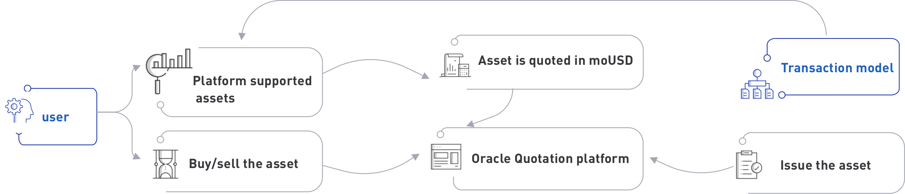
04
How the Global Debt Model works
User A status |  |  | User B status |  |  | Global state |  |  | result
Debt ($) | Synthetic assets | Synthetic asset value ($) | Debt ($) | Synthetic assets | Synthetic asset value ($) | Debt ($) | Synthetic assets | Synthetic asset value ($)
1000 | moUSD:1000 | 1000 | 1000 | moUSD:1000 | 1000 | 2000 | moUSD:2000 | 2000 | normal
1000 | moUSD:500 moTSLA:1 | 1000 | 1000 | moUSD:1000 | 1000 | 2000 | moUSD:1500 moTSLA:1 | 2000 | normal
1000 | moUSD:500 moTSLA:1 | 1000 | 1000 | moUSD:1000 | 1000 | 2000 | moUSD:1500 moTSLA:1 | 2000 | Synthetic asset value>debt, cannot be redeemed

Slide 9

04
Introducing Debt default vaults (DDV)
Mobius Finance will introduce a mechanism similar to an Insurance protocol to manage the global debt fluctuations.
An insurance product (Vault) will be created, users will be able to enter the vault by depositing their at face-value their crypto assets and becoming underwriters. In the scenario that the global debt increases, the funds deposited will be used to cover a share of the global debt; on the other hand, if the global debt decreases, the difference will be distributed to the vault participants as earnings. This is equivalent to all users becoming a counterparty during a normal transaction process.

Slide 10
05
The future of synthetic assets
Huge market
Stablecoin
No need to use complex cross-chain tools, just need to trade any asset in Mobius
moUSD naturally has usage scenarios and is a better decentralized stablecoin.
Pricing power
Bridge
When the trading volume reaches a certain threshold, the synthetic asset trading platform can have pricing power.
Traditional enterprises will launch their first decentralization attempt on the synthetic asset platform.

Slide 11
THANK YOU
Pedro Torres
2021

